Slide 1
Executive Office of Aging and Independence (AGE) Assisted Living Regulations and Enforcement
September 30, 2026
Liane Zeitz, CELA* Kathleen Lynch Moncata, Esq.
*Certified as a an Elder Law Attorney by the National Elder Law Foundation, the only national organization accredited by the American Bar Association to certify attorneys in elder law. Massachusetts does not recognize legal specialties for certification.

Slide 2

  Created as a residential model in MA.
  Not subject to federal regulation as are nursing homes.
  Provides certain landlord/tenant protections.
  Increasingly medical model - ALRs may be certified to provide “Basic Health Services.”
Assisted Living Residences

Slide 3
What is an
ALR?
G.L. 19D § 1
651 CMR 12.02 (Definitions)
  Assisted Living Residence
  Provides room and board
  Provides, directly through its employees, or through arrangement with another organization which the entity may or may not control or own
  Personal Care services to three or more adults who are not related by consanguinity or affinity to their care provider
  Collects payment or third party reimbursements from or on behalf of Residents to pay for the provisions of assistance with the Activities of Daily Living, or arranges for the same

Slide 4
Entities Not Covered by ALR Statute or Regulations
G.L. 19D § 3
651 CMR 12.01 (2) &(3)
    Certain entities are specifically excluded from ALR statute/regulations:
    CCRCs
    Group Homes
    Religious Orders
    Congregate Housing
    BUT Attorney General regulations (and Federal Ombudsman Statute) have an expanded definition

Slide 5
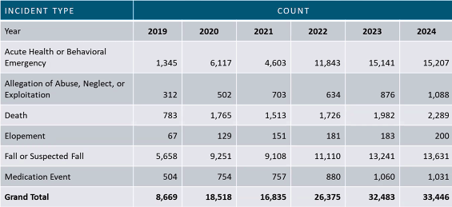
ALR Incident Report Trends
Source: ALR Commission Report (1/12/2026)

Slide 6
ALR Changes:
Chapter 197 of the Acts of 2024
Basic Health Services: ALRs able to provide basic health services, if certified by AGE
  Previously, no ALR could admit a Resident who requires 24-hour skilled nursing supervision
  Can admit if Resident elects to receive Basic Health Services from Residences that are certified to provide such services or from qualified third parties.
Created ALR Commission
  To study the regulations of ALRs

Slide 7
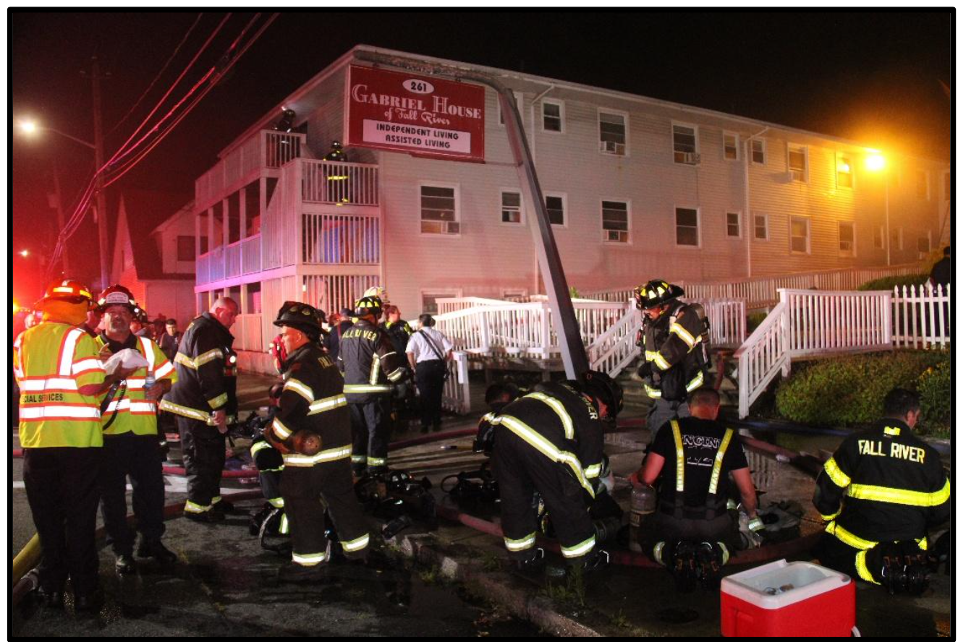
July 13, 2025: Photo courtesy of Retired Fall River Firefighter Kenneth Leger

Slide 8
ALR
Commission Recommendations
January 12, 2025
Standardize Disclosures to Improve Informed Decision-Making.
Clarify Assessments, Services and Costs as Needs Change.
Improve Accessibility of Public Information, Transparency and Accountability.
Strengthen Staffing & Promote Resident Voice.
Bolster Emergency Preparedness & Safety
Establish an ALR Affordability Task Force.

Slide 9
Fundamental Change
Previously, no ALR could admit a Resident who requires 24-hour skilled nursing supervision
Now can admit if Resident elects to receive Basic Health Services from ALRs that are certified to provide such services or elects to receive services from qualified third parties.
ALR cannot admit or retain a Resident who requires skilled care unless they agree to receive the Basic Health Services from the ALR or a qualified third party

Slide 10

New Regulations
Certification
Record Requirements
Staffing Requirements
Training Requirements
Residents Rights
Compliance Reviews

Slide 11
ALR Regulations
Significant Changes
651 CMR 12.00
Effective 7/31/26 some requirements phased in
  Basic Health Services – detailed requirements
  Some of the ALR Commission Recommendations
    Fire and Safety
    Personnel Qualifications
    Compliance/Sanctions
    Resident’s Rights

Slide 12

Basic Health Services

Slide 13
What Are Basic Health Services?
651 CMR 12.02
(Definitions)
Basic health services, certain services provided at an assisted living residence by employees of the residence that are qualified to administer such services or a qualified third party … provided, however, that such services shall include all of the following:
(i) injections;
(ii) the application or replacement of simple non-sterile dressings;
(iii) the management of oxygen on a regular and continuing basis;
(iv) specimen collection and the completion of a home diagnostic test, including, but not limited to, COVID-19 testing, influenza testing, warfarin, prothrombin or international normalized ratio testing and glucose testing ... and
(v) application of ointments or drops.

Slide 14
Certification and service requirements
Basic Health Services
Certification & Staffing
• AGE must certify ALRs who seek to provide Basic Health Services
• Yearly compliance review (versus every 2 years if not certified to provide Basic Health Services)
• If an ALR is certified to administer Basic Health Services, the ALR must offer all of the services
• Service may be provided by outside provider
• An ALR must provide 4 months notice to discontinue Basic Health Care Services 12.04(a)11.
Staffing and Training Requirements
• Must have daytime licensed nurse on premises 12.06(6)(d)
• Must have access to LPN or RN for consultation at all times. 12.06(6)(e)

Slide 15

Fire Protection; Emergency Planning;
Safety
Each ALR shall have a comprehensive disaster and emergency preparedness plan to meet potential disasters and emergencies, including fire; flood; severe weather; loss of heat, electricity, or water services; and Resident-specific crises, such as a missing Resident.
The plan is to be reviewed and updated every year.
12.03 Certification Process
12.04((1)Physical Requirements
  Requirements regarding CPR, AED (defibrillator), naloxone, epinephrine, oxygen, smoking, emergency response procedures

Slide 16
Plan development
Disaster and Emergency
Preparedness Plan.
The plan shall be developed in conjunction with local and state emergency planners as well as local and state fire and safety experts, and shall include:
• an evacuation strategy (both immediate and delayed)
• an established Mutual Aid plan that addresses essential issues, such as supplies, staff, and beds;
• the provisions of subsistence needs for staff and Residents;
• an established relationship with local public safety officials and with local Emergency Management Services (EMS) officials;
• participation in Health and Homeland Alert Network (HHAN);
• protocols for full participation in safety alert or notification systems
Ongoing compliance
• All ALRs shall have an approved annual fire inspection by the local fire department.
• The emergency response system must be tested at a minimum quarterly. These tests must be documented.

Slide 17
Staffing
If resident care director is not a licensed nurse, must work with a LPN 12.04(2)(6)
LPN must conduct initial visits and assessments, oversee medication programs, provision of personal services
Requirements for Orientation, Training, On-going Education
No changes to requirements for Executive Director (as recommended by Commission)
Resident Care Director – must have 5 years experience or nursing degree plus 2 years experience, effective for hires after 1/1/2027

Slide 18
Special Care Residence Staffing (unchanged)
Staffing
A Special Care Residence shall have sufficient staff qualified by training and experience awake and on duty at all times to meet the 24-hour per day scheduled and reasonably foreseeable unscheduled needs of all Residents of a Special Care Residence based upon the Resident assessments and Service Plans. It shall NEVER be considered sufficient to have fewer than two staff members in a Special Care Residence, except ALR can request a staffing exemption
Staffing for Basic Health Services.
Basic Health Services must be provided by a Clinical Professional capable of providing such services within their scope of practice. The ALR shall have a licensed nurse working on the Residence's premises for at least 16 hours during the day (e.g., 7:00 A.M. through 11:00 P.M.) each day.

Slide 19
Licensed Nurse
Required availability
Licensed Nurse
The ALR must designate at least one licensed nurse who is employed by the ALR or engaged under a written agreement to:
• Complete initial clinical assessments before each Resident moves in;
• Oversee Self-Administered Medication Management (SAMM);
• RN must provide the required 20 hours of Personal Care Services training for applicable staff and conduct biannual evaluations of Personal Care Staff;
• Oversee and provide Limited Medication Administration (LMA) for Residents; and
• Develop and oversee required Service Plans.
The designated licensed nurse must provide on site services for a minimum number of hours each week, scaled to the ALR's size, Resident acuity and needs, and be available on call 24 hours a day to support staff and respond to changes in Resident condition.
As of January 1, 2027
An ALR must have a minimum of one staff member available at all times who is certified in cardiopulmonary resuscitation (CPR) and in the use of an automated external defibrillator (AED).

Slide 20
Residence Obligations
Service Plans
• Developed prior to admission, with periodic reviews every 6 months, every 3 months for Basic Health services, or following a change in condition;
• Signed by an LPN;
• May include a personal emergency response system that requires a timely answer within 10 minutes.
Additional obligations
• Special Care residents to receive documented hourly safety checks overnight;
• Quality Assurance and Performance Improvement Committee;
• Record requirements: Census; Communication Log; Fall Log; Emergency Response Log
• Audit of Medication Errors
• ALR to report serious incident within 24 hours

Slide 21
Non-Regulatory
ALR Uniform Disclosure Form to be finalized
Website - transparency of information
  AGE website should have more information available to residents, prospective residents
AGE collecting more information on ownership, changes in ownership, census of residents

Slide 22
Owner
Information
Disclosure
Require greater disclosure of owner information:
ALR Identifies to AGE the name, address of each owner, general partner, limited partner or shareholder with a 5% interest or greater interest in the ALR;
A change or ownership results in a certification by AGE;
Within five days after a transfer of ownership, an ALR must notify residents; and
ALR must make ownership information available to all residents and all prospective residents upon request.

Slide 24
ENFORCEMENT OPTIONS
Not mutually exclusive

Slide 25
Ombudsman Program
A. Independent of AGE (under EOHHS)
B. Authorized to identify, investigate and resolve complaints
C. Can report to enforcement agencies
D. BUT – no authority to sanction ALR
42 USC § 305g
GL 6A § 16CC
101 CMR 30.00

Slide 26
AGE
A. No specific regulations regarding complaint investigation.
B. Complaint form on AGE website - can be completed online or by mail: https://www.mass.gov/assisted-living-residences
C. AGE can follow-up with certification review.
D. AGE has authority to issue penalties/sanctions.
E. Resident does not automatically get a response from AGE regarding complaint investigation.

Slide 27
Corrective Action
Whenever AGE finds, upon inspection or through information in its possession, that an ALR is not in compliance with any law(s), regulation(s), governing such program, AGE may, in its discretion, require the ALR to implement any corrective action it deems necessary, including:
1. Ceasing the enrollment of new Residents;
2. Reducing the number of Residents served;
3. Changing the staffing patterns or staffing levels, or staffing qualifications; or
4. Requiring additional training of the Executive Director or staff.

Slide 28
Modification,
Suspension,
Revocation or Fine
In General.
If AGE determines that there has been a failure or refusal to comply with the requirements of 651 CMR 12.00 or any applicable statute or other legal requirement, AGE may issue a fine of not more than $500 for each day of each such failure or refusal to comply.
Basic Health Services.
If AGE determines that an ALR provided or offered to provide Basic Health Services without Certification to provide Basic Health Services, ALR may issue a fine of not more than $1,000.00 per day for each day of such provision or offering, or both.
Effect.
An Applicant or Sponsor shall not qualify for a Certification from AGE for five years after a final agency decision to revoke or refuse to issue or renew a Certification held by the Applicant or Sponsor.

Slide 29

Elder Abuse Reporting
For suspected elder abuse or neglect or financial exploitation in MA, contact:
Massachusetts Elder Abuse Hotline:
800-922-2275

Slide 30
Attorney General’s Office
Violation of AGE regulations is a violation of 93A
More from John Ford slide show

Slide 31
Other Resources
Private Attorney
Legal Services
Care Manager
Cannot be evicted without summary process action
Should consult an attorney
Evictions should be a priority for legal services programs, subject to their capacity
Consult with an Aging Life Advocate (quality of care issue)

