Slide 1

An Overview of PACE
Dignity Alliance Study Session
5/26/2026
Notes:
Updated 5/2025

Slide 2
Defining PACE
PACE stands for “Program of All-inclusive Care for the Elderly”: is a provider-based, fully integrated healthcare plan for individuals who are aged 55 and over and have significant healthcare needs.
PACE is the alternative to the nursing home; you get all the care you need all while staying put in your community where you feel comfortable.
PACE
All you need in one place.
masspace.net

Slide 3
What Is PACE?
Program of All-Inclusive Care for the Elderly
A Medicare program and Medicaid state option that gives community-based care and services to people 55 or older who otherwise would need a nursing home level of care.
An integrated system of care for nursing home eligible older adults that is:
Community-based
Comprehensive
Capitated
Coordinated
PACE
PACE
All you need in one place.
masspace.net
All you need in one place.
masspace.net
Notes:
PACE is both a health provider and a health plan
Full financial risk
Comprehensive services
Directly employed interdisciplinary team
that manages each participant’s care

Slide 4

PACE Model Philosophy
The PACE Model of Care is centered on the belief that the well-being of older adults with chronic care needs and their families should be served in the community whenever possible.
Honoring the wants and needs of older adults and their families:
  To be cared for in familiar surroundings
  To maintain the autonomy of their care
  To maintain a maximum level of physical, social, and cognitive function
PACE
PACE
All you need in one place.
masspace.net
All you need in one place.
masspace.net

Slide 5
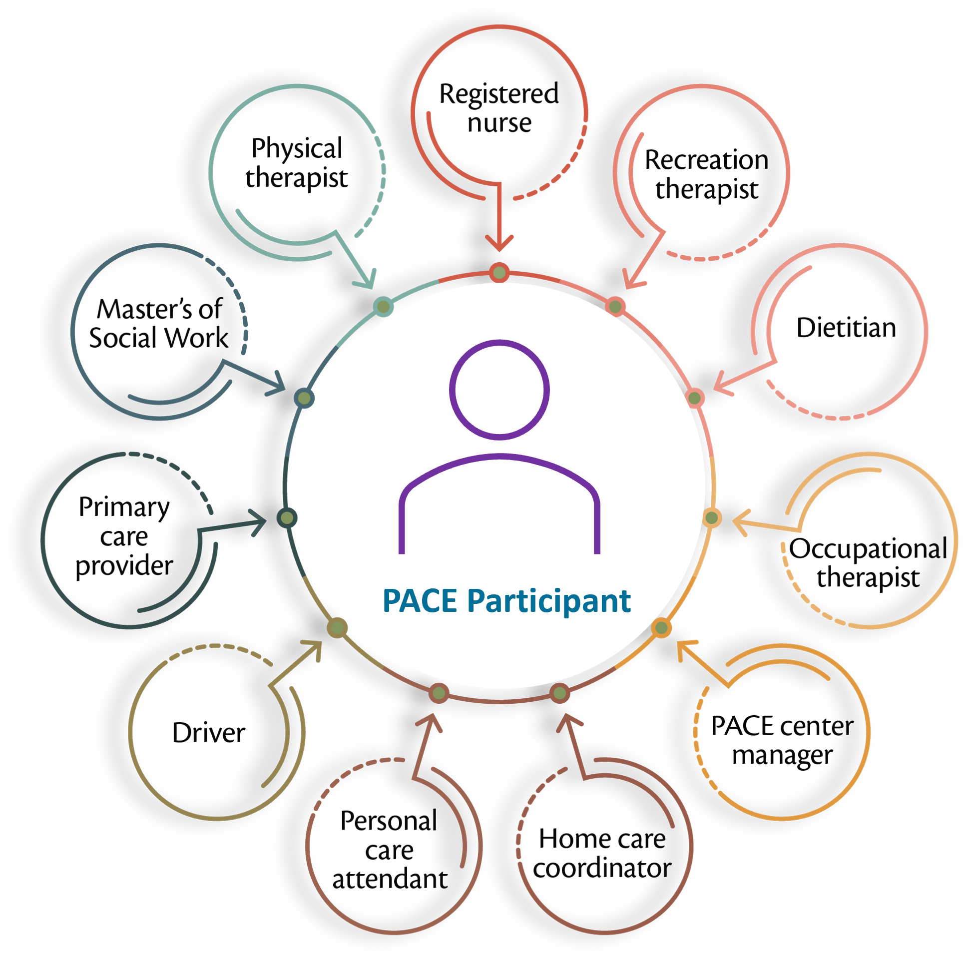
PACE Model of Care
PACE participants are served by an 11-member interdisciplinary team (IDT).
PACE participants receive services at the PACE center and their homes.
PACE is a Part D provider and provides full prescription drug coverage, including all Medicare, Medicaid, and medically necessary services, with no benefit limitations, copays, or deductibles
PACE programs receive capitated payments per participant and are at full risk for the services provided; payments do not change based on the utilization patterns of participants.
PACE
PACE
All you need in one place.
masspace.net
All you need in one place.
masspace.net
Notes:
The PACE IDT takes care of:
Scheduling transportation to medical appointments
Day programs at the PACE Center or elsewhere
Deliveries of medications and meals to the homes
Social services that make sure the home environment is safe and appropriate

Slide 6
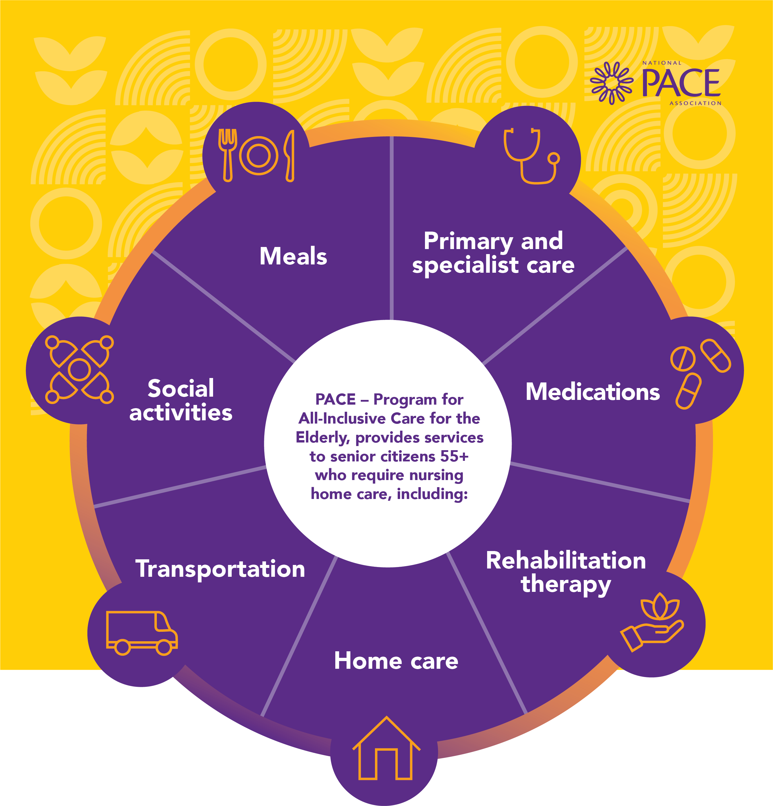
Other Services Provided
Behavioral Health
Nursing
Nutritional Counseling
Social Work
Medical Care
Personal Care
Social Services
Audiology
Dentistry
Optometry
Podiatry
Respite Care
Care Management
And More, with No COPAYS
Hospital and nursing home care are provided when necessary.
Any other care, services, or supports deemed medically necessary to maintain or improve the health status of participants.
PACE
PACE
All you need in one place.
masspace.net
All you need in one place.
masspace.net
Notes:
Note that PACE programs often contract with outside providers for these services – like most plans, they have networks

Slide 7

The Interdisciplinary Team (IDT)
The PACE IDT huddles daily, sometimes twice daily, to discuss any episodes relating to any participant enrolled in that PACE program so that interventions can be implemented quickly before the health episode escalates unnecessarily.
Should something happen that results in an older adult moving to a nursing facility, the IDT continues to coordinate care, and PACE pays for it
PACE
PACE
All you need in one place.
masspace.net
All you need in one place.
masspace.net
Notes:
Cover service requests

Slide 8

PACE
PACE
All you need in one place.
masspace.net
All you need in one place.
masspace.net

Slide 9
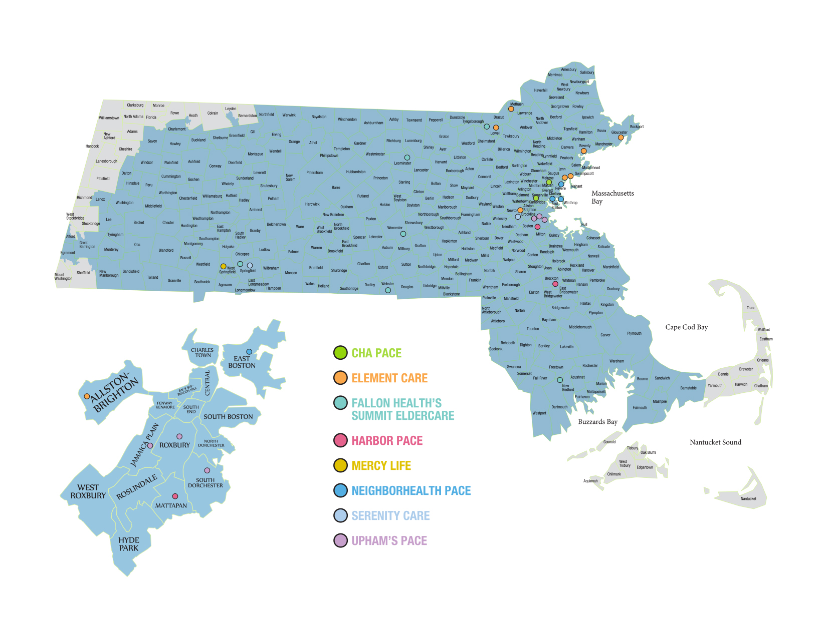
Where is PACE Available?
Currently 8 PACE organizations together operate 20+ PACE Centers serving over 6K individuals.
Search PACE by Zip Code
PACE
PACE
All you need in one place.
masspace.net
All you need in one place.
masspace.net
Notes:
Zip code finder

Slide 10








PACE Organizations in MA
PACE
PACE
All you need in one place.
masspace.net
All you need in one place.
masspace.net

Slide 11
TODAY
PACE programs are authorized by each state’s Medicaid agency and is jointly administered with CMS
PACE is currently in 33 states and the District of Columbia and growing
Over 100K+ participants served nationally across 200 PACE Programs
In MA programs are awarded coverage by zip code.
Source: NPA PACE by the Numbers 2025
PACE
PACE
All you need in one place.
masspace.net
All you need in one place.
masspace.net

Slide 12
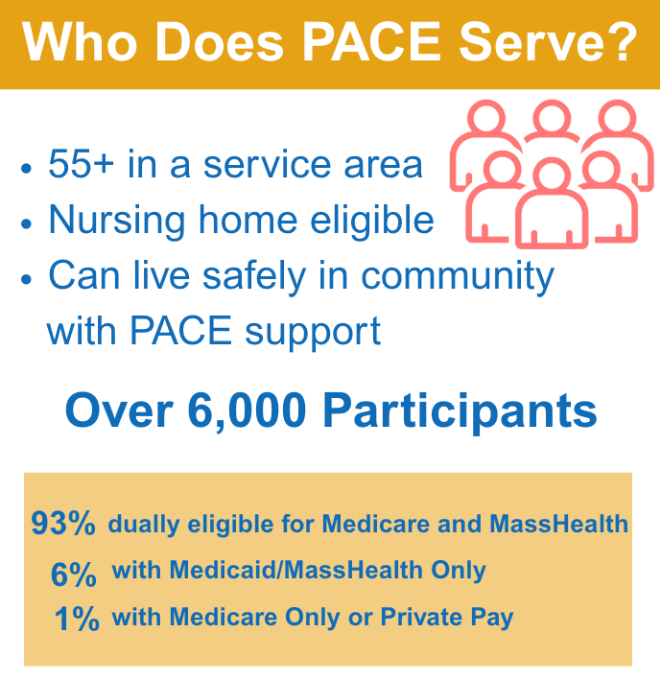

Who We Serve
PACE
PACE
All you need in one place.
masspace.net
All you need in one place.
masspace.net

Slide 13
Paying for PACE
Source of Payment to PACE | Cost to Participant
MassHealth & Medicare | No share of cost, provided the individual makes below 300% of the Federal Benefit Rate (FBR). In 2026 this amount is $2,982/month along with an asset test.
MassHealth & Medicare | Spend down for MassHealth if income is above 300% FBR as described HERE
MassHealth Only | No share of cost
Medicare Only | A calculation of the MassHealth Dual Rate and Part D Premium (typically upwards of $5k).
Private Pay | For individuals who do not qualify for MassHealth or Medicare, pays full cost of MassHealth Duals Rate, Medicare PMPM, and Part D Premium.
In all circumstances, the individual must meet the clinical criteria. There are also calculations for individuals that may have Medicare part A but not part B and vice versa. The PACE program would help calculate what the payment would be. Once enrolled there are no co-pays or limits.
PACE
PACE
All you need in one place.
masspace.net
All you need in one place.
masspace.net
Notes:
Discuss policy changes – Spousal Asset, Lookback, Medicaid only

Slide 14

Want to Keep Learning?
Download PACE and Housing Report Today!
Visit our Website to sign up for trainings, read our blogs, join our advocacy!
PACE
PACE
All you need in one place.
masspace.net
All you need in one place.
masspace.net

Slide 15
Q & A
PACE
PACE
All you need in one place.
masspace.net
All you need in one place.
masspace.net

Slide 16
Our Mission & Vision
The MassPACE Association’s mission is, through advocacy, education, and policy research, to provide leadership and support for growth, access, quality, and success of PACE in the Commonwealth of MA.
MassPACE Vision: PACE is accessible to every eligible consumer in the Commonwealth of MA and recognized as an extraordinarily innovative, accessible, valuable and effective model of care for individuals with significant health care needs.
PACE
PACE
All you need in one place.
masspace.net
All you need in one place.
masspace.net

Slide 17

Contact:
Jennifer Maynard Batcheller, DHSc, MPA, RN
Executive Director
jmaynard@masspace.net
Anne Rogers Program & Communications Associate
arogers@masspace.net
Connect:
LinkedIn
Facebook
Twitter/X
Vimeo
Thank you!
PACE
PACE
All you need in one place.
masspace.net
All you need in one place.
masspace.net

