Slide 1
MASSACHUSETTS GUARDIANSHIP POLICY INSTITUTE –
WHO WE ARE AND WHAT WE DO
1. Brief History of Organizing and Advocacy
2. The Institute -https://guardianship.institute/
3. Center for Guardianship Excellence - https://guardianshipcenter.org/
4. Public Guardian Services - https://www.publicguardianservices.org/
5. Newsletter, Beyond Guardianship, Feb.2026
https://guardianship.institute/newsletter-February-2026/

Slide 2

MASSACHUSETTS DOES NOT HAVE
A STATEWIDE PUBLIC GUARDIAN PROGRAM
2014 Task Force Massachusetts Policy Institute
Identified stakeholders & allies for steering committee
      Other advocacy groups
      Legislators
      State Courts
      Elder Law Attorneys
Identified unmet needs and cost savings
  Collaboration with Harvard Medical School
  found 3000-4000 at risk adults in need of guardianship with no decision-makers
  Study revealed patient health crisis
  Study revealed cost overruns for hospitals
Notes:
Brief history in Mass- Background: No Statewide Public Guardian Program);
Organizing, and advocating for funding for statewide public guardian, leading to a strategy to establish a Pilot Public Guardian program, by –
Strategy – Think broadly regarding collaborating and funding.
Organizing our advocacy Task Force 2014– Massachusetts Guardianship Policy Institute (Institute) to carry out education, research, advocacy, collaboration. Brief presentation on the components for the Institute
Organizing, identifying stakeholders and allies with common or overlapping interests – Stakeholders include: Other advocates (elder rights, nursing home residents rights, disability rights, ARCs); Government agencies( Adult Protective Services, DMH, DDS); AAAs; Courts; hospitals; State guardianship association and other guardianship programs; Elder Law Attorneys; universities; former state government officials; legislators.
Formulation of a Steering Committee; state WINGS program.
Identifying the unmet need for and cost savings from a public guardian: Our researchers collaborated with Harvard Medical School to find that 3000-4000 adults were at risk for lack of a guardian. This resulted in patients getting stuck in hospitals, increasing costs for the hospitals and the state, and impacting patients’ health.

Slide 3
MASSACHUSETTS DOES NOT HAVE
A STATEWIDE PUBLIC GUARDIAN PROGRAM
2014-2025: Massachusetts Policy Institute
Advocacy through education
  Organized conferences to share public guardian program models from other states, alternatives to guardianship, diverse populations, rights of adults facing guardianship, obligations of guardians
  Filed bills to establish and fund statewide public guardianship
  Held legislative briefings, recruited sponsors for Medicaid funding bill
  Filed Guardian as Provider Bill
  Law enacted requiring DPH to study and report on need for public guardians
Notes:
Advocating and organizing through education – Institute presented multiple conferences to our wide audience of stakeholders on such issues as guardianship models in other states; alternatives to guardianship; the needs of different groups who might need guardianship; good guardianship models; how guardians should make decisions. These conferences broadened our audience, and the range of our involved stakeholders.
Continuing to do Legislative advocacy to educate and involve legislators to support the need for a public guardian
Filed bills to establish a state funded, statewide Public Guardian program
Held a legislative briefing and recruited sponsors and co-sponsors for a Bill to establish Guardians as Providers under Medicaid to support more guardians
Enacted a law requiring Department of Public Health to study and report on the need for public guardians, funding options, and costs and benefits of public guardians

Slide 4
CENTER FOR GUARDIANSHIP EXCELLENCE
Our vision is a world in which all guardians are trained and supported to be the best possible advocates for people with a guardian. We strive to make research accessible to those serving as guardians through fact sheets, infographics, and decision-making tools. We believe the Center’s work will lead to high-quality support for people subject to guardianship.
Research –
Education – numerous free and low cost resources for family, and professional guardians, including best practices for decision-making; obligations of guardians; rights of persons facing guardianship; support groups and networking; trainings for guardianship certification; ethical issues.
https://guardianshipcenter.org/

Slide 5

PILOT PROGRAM BEGINS
2019 Pilot Public Guardian Services
  Non-profit with private funding
  Board included stakeholders
  Operating in 3 counties
  Model for the state
  Need for stable, adequate funding
  Person-centered guardianship
Notes:
2020 Established our Pilot Public Guardian Services for three Massachusetts counties to serve as model for the state for adequately funded good guardianship, guardian of last resort
Structural Options: Depends on your state and your legal and funding options:
Government as guardian by state or county
Government contract to non-profit partner
Public agency appointment of private individuals
Privately funded non-profit Public Guardian (our model)
Potential ethical issue – if funding comes from an entity that provides services to your clients, potential conflict of interest
As a non-profit, we structured our Board to include stakeholders identified above.
Our Funding – from a private non-profit pooled trust, Guardian Community Trust, a unique model, which has been sustainable
Other Funding options– important to think broadly, to reach out to possible funding groups with shared, overlapping interests, including hospitals and nursing homes who need informed consent to discharge some patients; government agencies who serve the same populations, private foundations
ACL Elder Justice Innovation Grants to state courts for guardianship reform – NYC Guardianship program received this funding
For example, Area Agencies on Aging with Older Americans Act funding. We had a grant from the Boston AAA.
How to increase and fund public guardians statewide -Guardians as Providers

Slide 6
PUBLIC GUARDIAN SERVICES’ MISSION
Public Guardian Services provides guardianship and conservatorship services to indigent Massachusetts adults in Suffolk, Norfolk and Plymouth Counties who are decisionally impaired and who have no other suitable person to help.
Public Guardian Services provides stability by making informed decisions about needed personal, medical, social and housing services while respecting our client’s wishes, preferences, and capacity, maximizing independence, and choosing the least restrictive alternatives.
Our approach as guardian is to support our clients so they can live as independently as possible.

Slide 7
Staffing & Standards for Pilot Program
  Established standard for capacity, 20 cases per case manager
  Four experienced social workers with diverse backgrounds
  Each guardian brought work experience with 1+ populations we serve
  Person-centered social work methodology for understanding clients, client needs, client preferences and best practices for surrogate decision-making
  Executive Director/Legal Director
  Clinical Director
  Office Manager
Notes:
Develop and structure hiring and training for Public Guardian Services, within budget – 2020 (Covid challenges)
Establish standards for staffing and capacity of program – NGA standard for good guardianship, 20 cases per social worker
Need to serve diverse populations with different needs
Social work, person-centered model for good guardianship raining and ongoing supervision standards
With these standards and our budget, we developed a job description. Our goal was to hire 4 care managers/social workers, from diverse populations, with work and educational experience to serve 20 clients, and different needs. We achieved this goal. Each of our 4 social workers has formal social work education and credentials, and each has prior work experience with one or more of the populations served.
Our staffing - Full time Executive Director/Legal Director; full-time Clinical Director, Full time Office manager, 4 full-time care managers. We do not bring petitions. We have outside Counsel for more extensive legal work.
Initial training - Structured training from experts
Guardianship Law and Court Process, Court reporting, legal definition of incapacity, least restrictive alternatives , decision making standards ( best interests, substituted judgement) restoration of rights – training from Mass. Probate and Family Court Chief Lawyer
NGA Standards for Guardians, kinds of decisions and how Guardians make decisions, safety vs. autonomy, person-centered guardianship, focus on Least restrictive alternatives, ethical issues, confidentiality -training by Heather Connors PhD
History of Guardianship and Guardianship advocacy in Massachusetts -training by former Attorney General, and Institute Advocates

Slide 8
$6,000,000 SPENT ON PILOT SO FAR
ANNUAL BUDGET $1,000,000 to $1,200,000 so far
  $10,000 - 12,000 per client per year x 80 cases plus admin/overhead
CASES
  Guardian 78 (Guardian of the Person)
  Conservator 28 (Guardian of the Estate)
LIVING ARRANGEMENTS
  SNF
  Assisted Living
  Community
  Hospital
Age 60+ = 58 clients, Age 18- 59= 18 clients
Notes:
need to add
total clients -74 (at this moment)
and add Clients under 60- it is 16
Our Budget - annually approximately $950,000 total, approximately $10,000 per client per year, 80 cases. Since 2020, GCT has spent $5 million on our pilot project.
Cases -
Guardian – 78, Conservator – 28
Age: 60 plus – 58; under 60 – 14
Placement:
SNF- 57
Assisted Living – 1
Community – 11
Hospital - 3

Slide 9
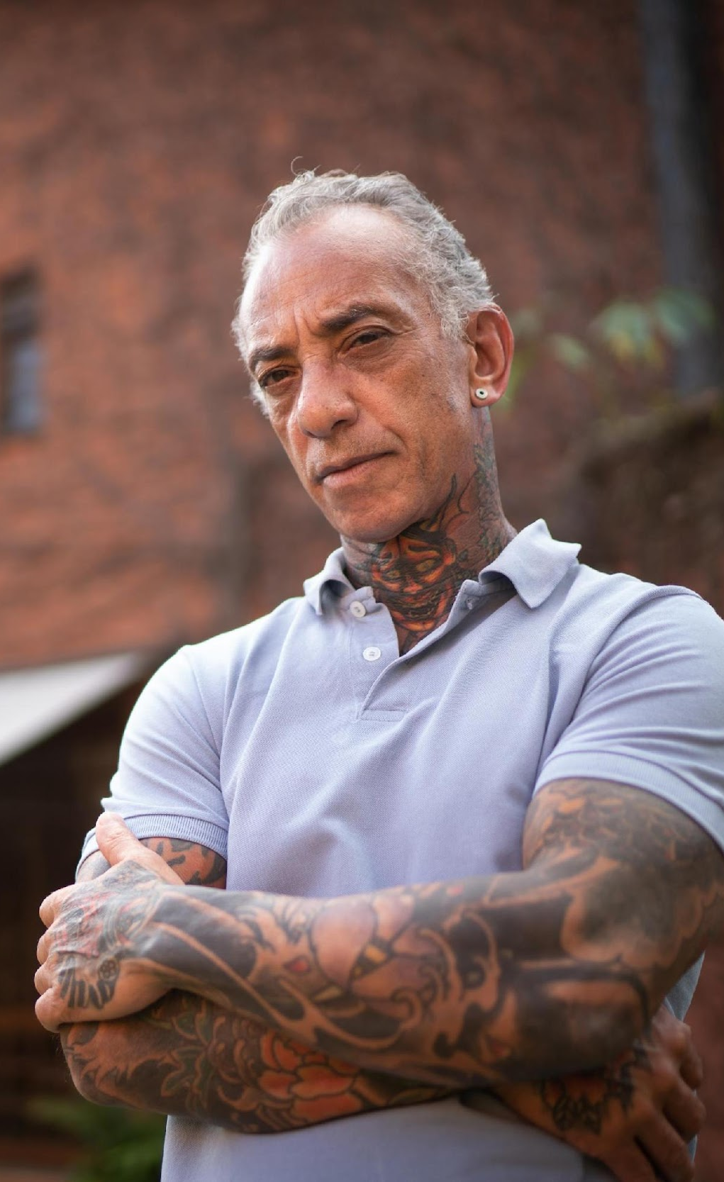
MEET RICH, 56
2021 Referral
Unhoused and living with Schizophrenia diagnosis
Initial meeting during 1 of many hospitalizations
Guardian spent time building trust while Rich was in the hospital. Learned about his life. Learned his concerns about meds. Not interested in housing.
2023 New Diagnosis
Cancer diagnosis with nursing home recommendation. Rich refused. Finally agreed to group home with support for taking meds
Guardian took him to medical appointments, encouraged treatment
2025 Remission & Stability
Safe and comfortable home and proper medications
Notes:
Client story
In 2021,PGS became guardian of a homeless 56-year-old schizophrenic man, Richard. He was often unreachable. He was in and out of hospitals, during which the PGS social worker took the opportunity to get to know him. He was later diagnosed with cancer, and a nursing home was recommended. He refused. His guardian supported him because she knew his wishes. After much trust-building, she was able to get Richard got into a group home. He now takes his anti-psychotic medications, goes to his medical appointments with his Guardian. His condition is stable and he no longer goes into to a hospital several times a year.

Slide 10
CHALLENGES & Ethical Issues
Client-Related Challenges
People with complex social & medical cases
People who are difficult to find homes for
Geographic issues using time
Family dynamics that involve anger, etc.
Unexpected necessary expenses
  Example: $20,000 costs for litigation with family members
Ethical Challenges
Decision-Making standards
End of Life decisions including DNR/DNI
Notes:
Decision making standards - autonomy vs risk, best interest, substituted judgment ,
other interested parties - family members, medical providers
Decision-making standards
End of life decisions and Do Not Resuscitate Issues

Slide 11
LESSONS LEARNED
10-Year Review & Recommendations
Social work, person centered guardianship
Secure dedicated and sufficient funding to ensure sustainability
Recognize the strong potential of cost savings in other areas
Learn from successful models in other states
Need for strong organization and leadership
Foster collaboration and leadership among stakeholders to promote a unified and effective approach to policy reforms
Ten Year Review and Recommendations - https://guardianship.institute/ten-year-report-on-public-guardianship-massachusetts/

