Slide 1
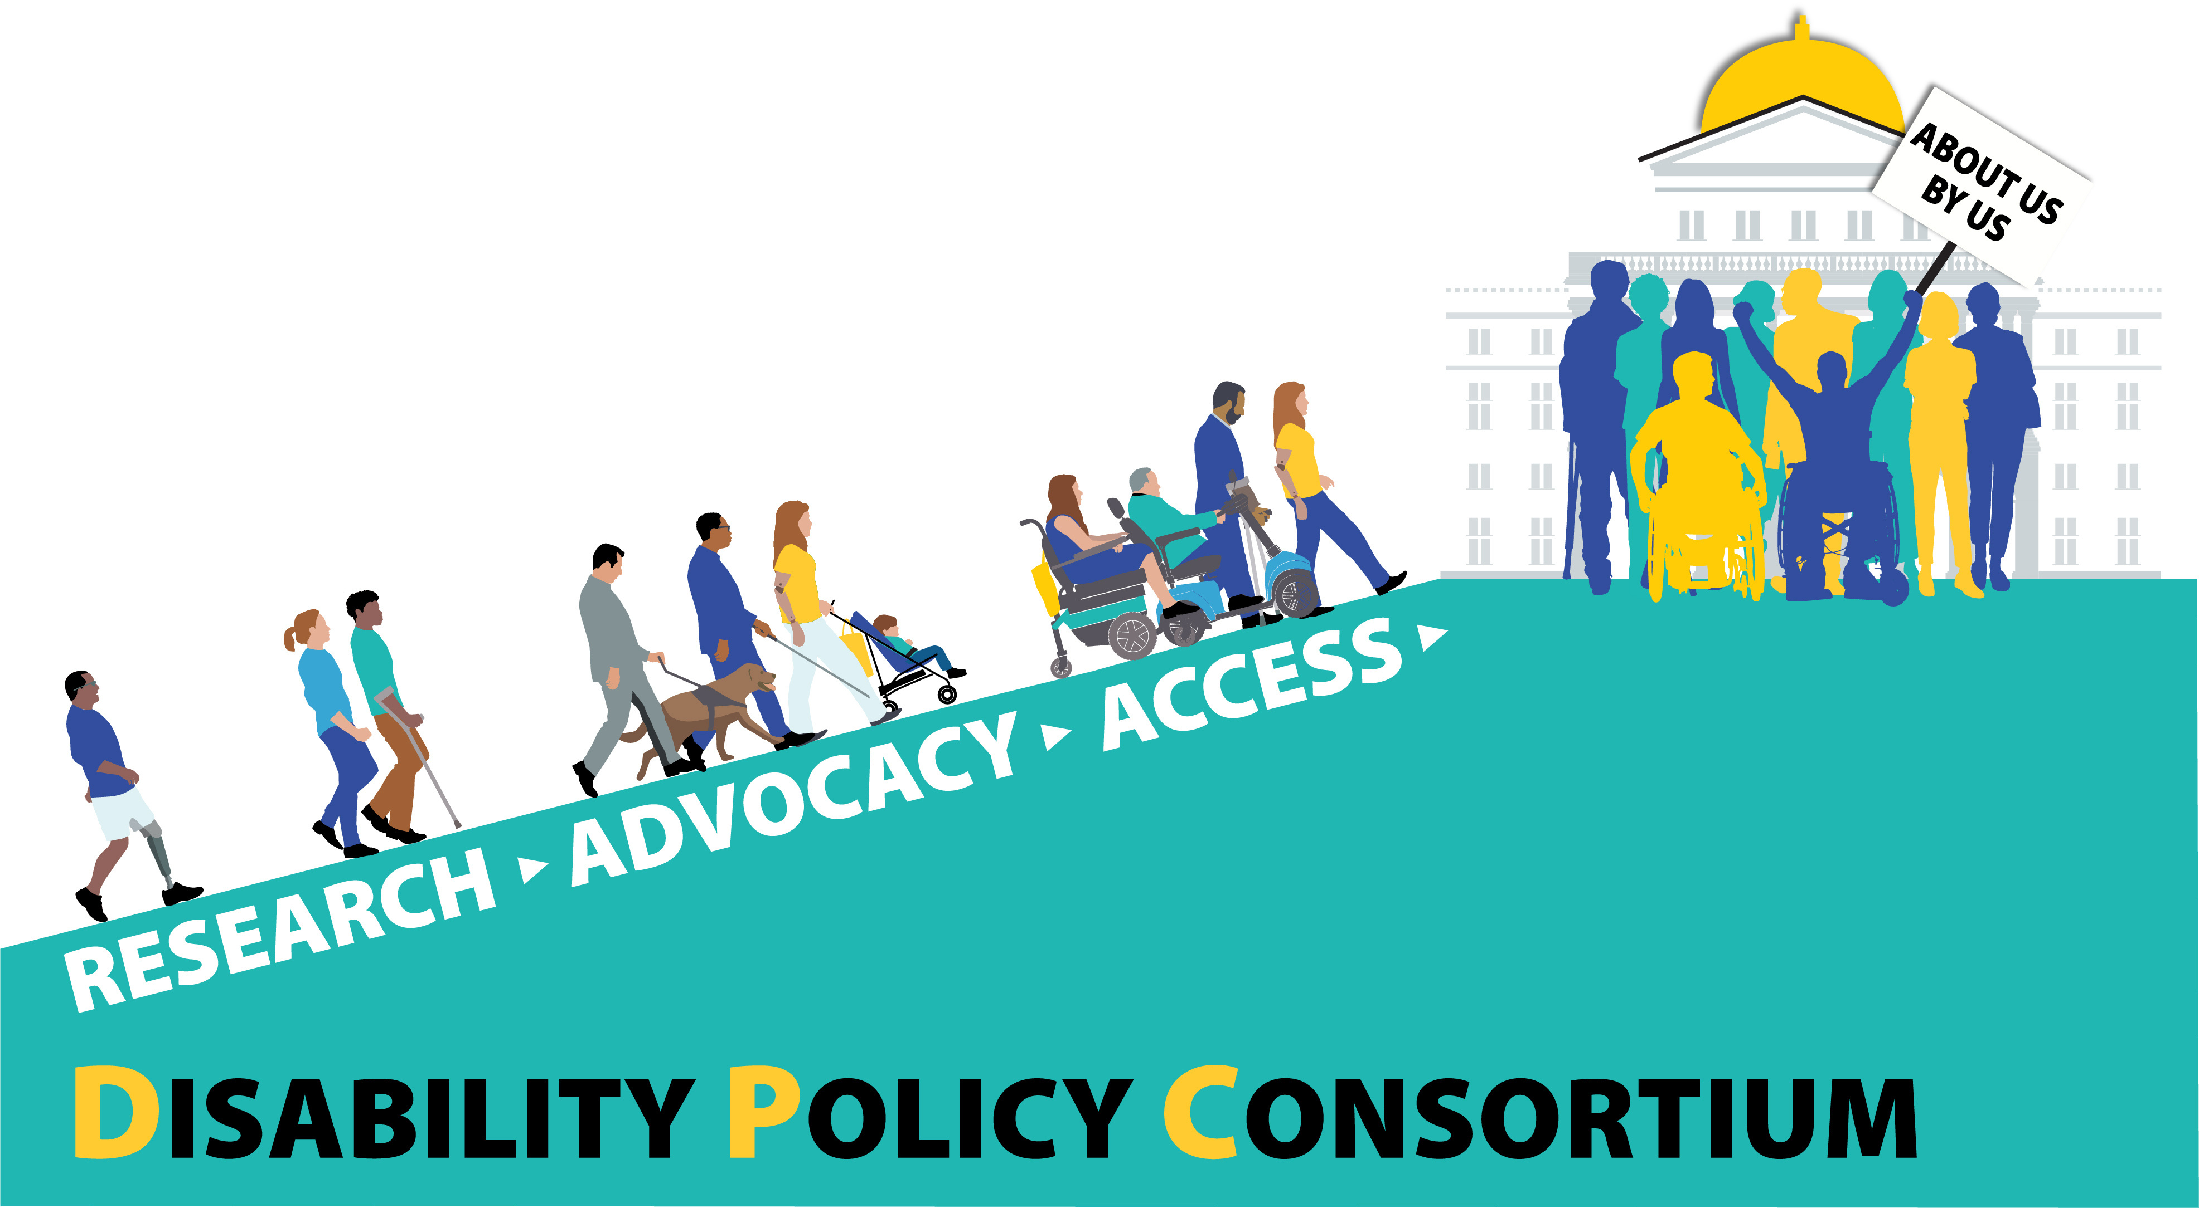

Disability Policy Consortium
Dignity Alliance Focus Presentation
www.dpcma.org

Slide 2

Overview
DPC is Massachusetts’ leading disability rights advocacy organization.
Guided by the credo "About Us, By Us," our mission is to ensure that the disability community plays a leading role in making decisions that affect our lives
We accomplish this through:
  Grassroots advocacy & policy development
  Community-based, participatory action research (CBPAR)
  Disability-led training and consulting services
  Helping people with and without disabilities get the care they need from their health insurance plans
Large majority of staff and board have disabilities
Check out DPC's 2025 Impact Report

Slide 3

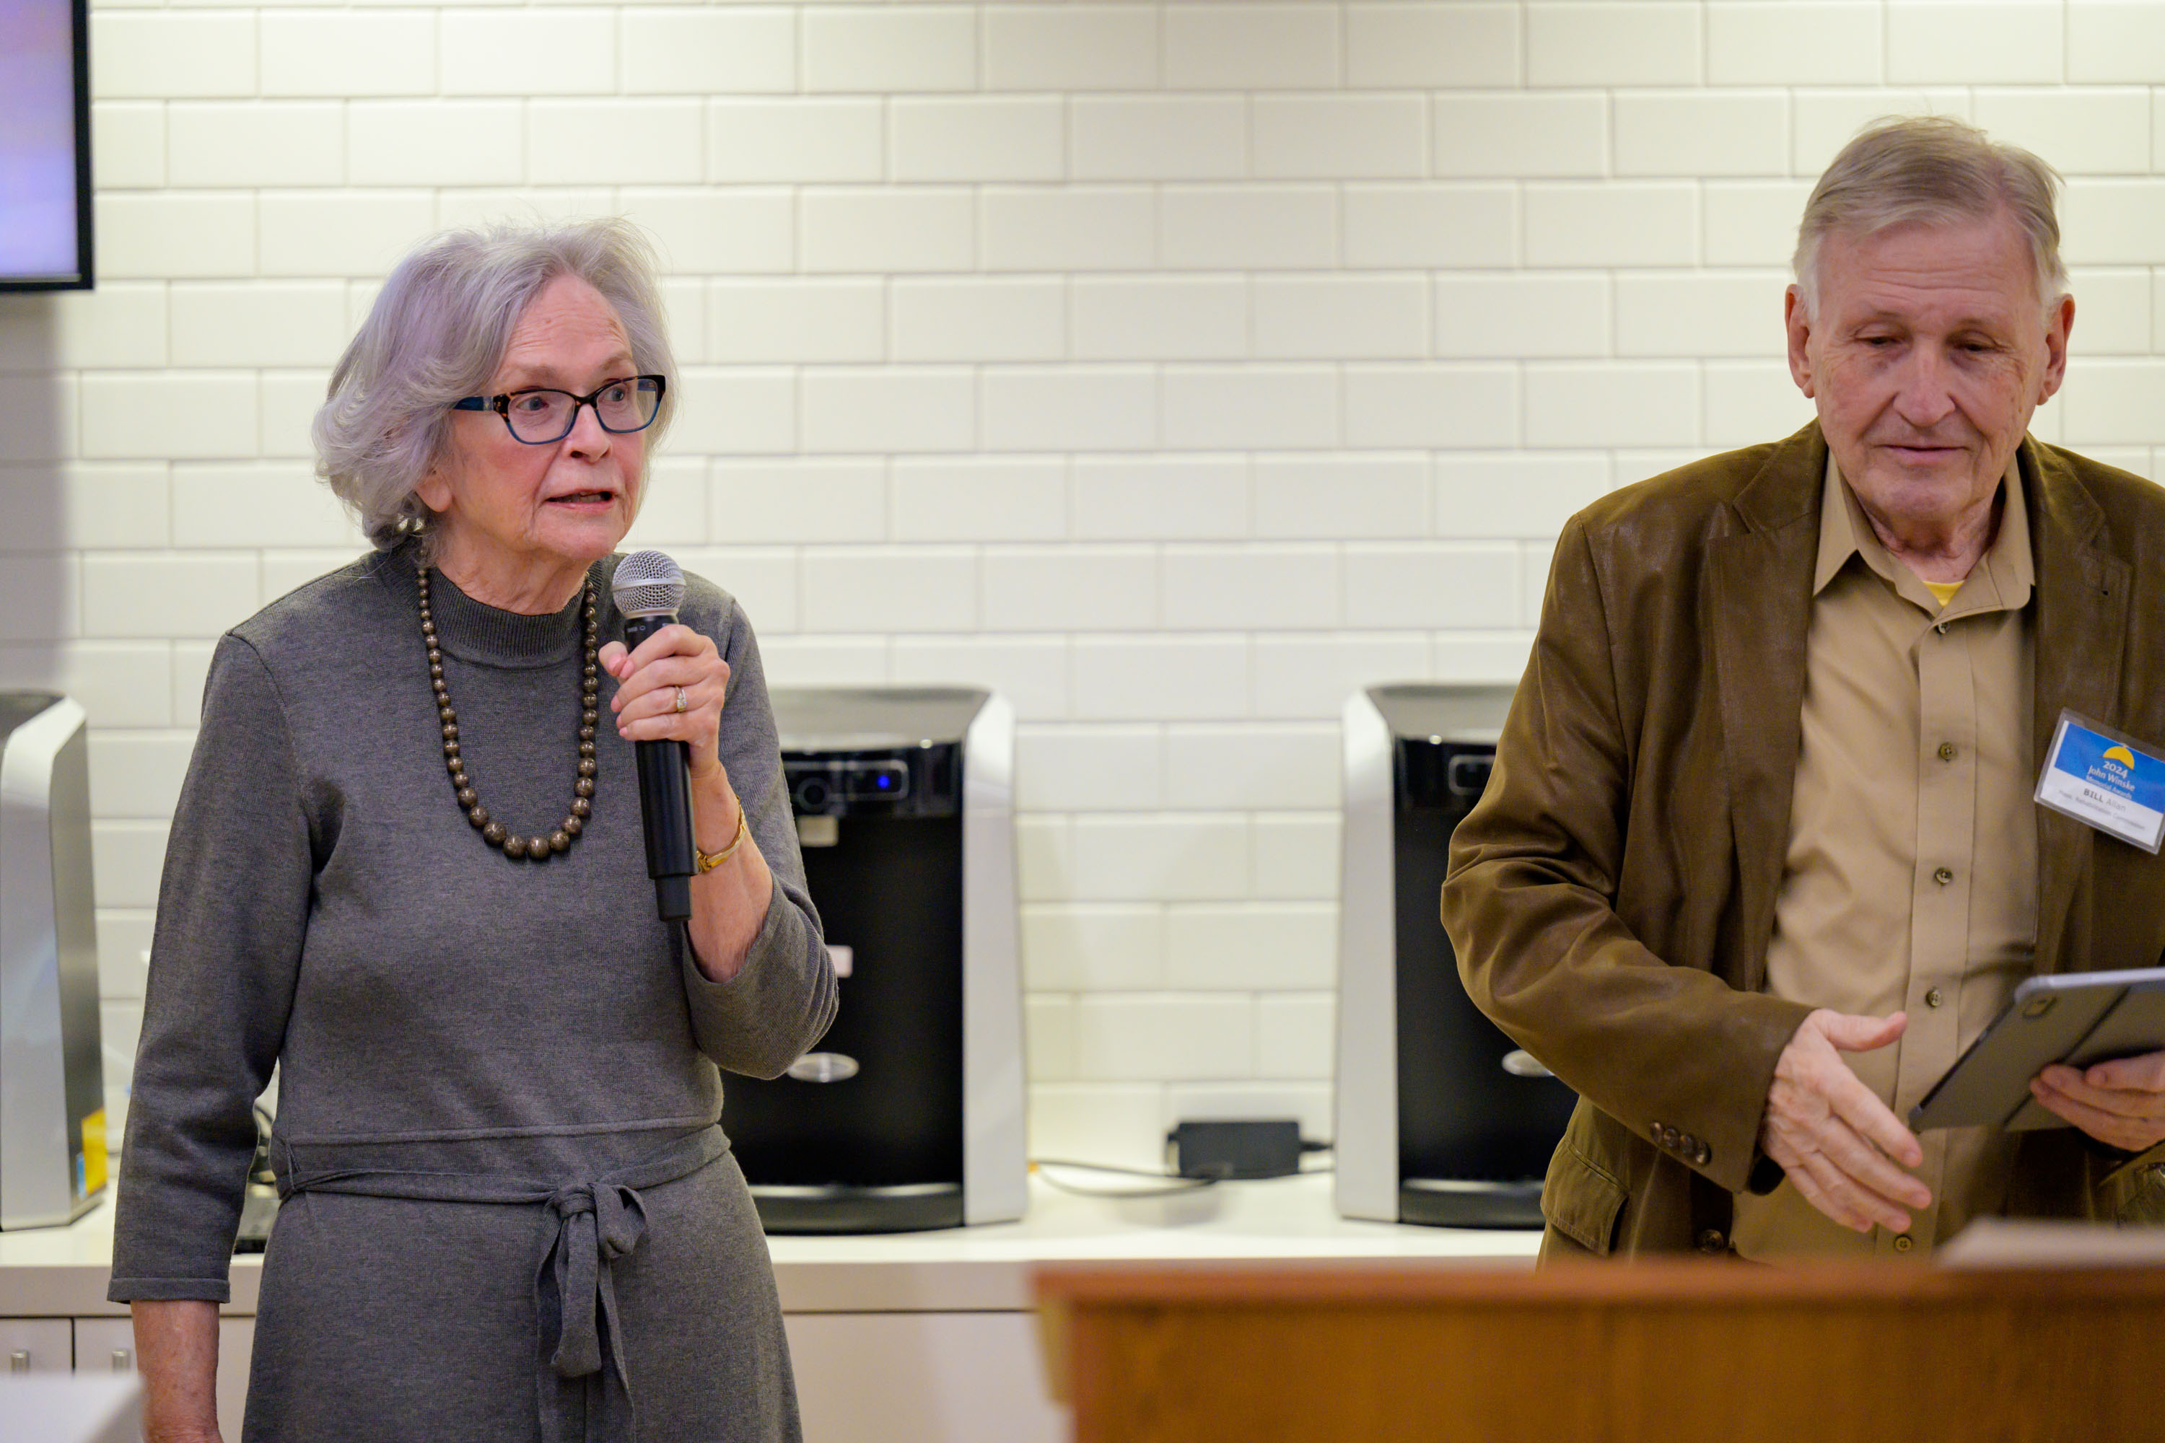
Celebrating 30 Years
Founded in 1996

Slide 4
Advocacy
Grassroots community organizing
Legislative and state policy
Building leadership among MA disability community
Empowering people with disabilities and allies to advocate for disability rights
Collaborating with partners and state officials
DPC's full Legislative Access Agenda: https://www.dpcma.org/legislative-priorities

Slide 5
Recent and Current Advocacy
Passing estate recovery reform
Changing state house rules to give enough advance notice of hearings to request ASL interpreters
Preventing collapse of CCA, which serves 30,000 One Care members and 15,000 SCO members
Wheelchair repair reform
Health care anti-discrimination
Improving access to affordable accessible housing
Insurance coverage for hearing aids
Developing new MA disability leaders via Paul Spooner Generational Leadership Summit

Slide 6
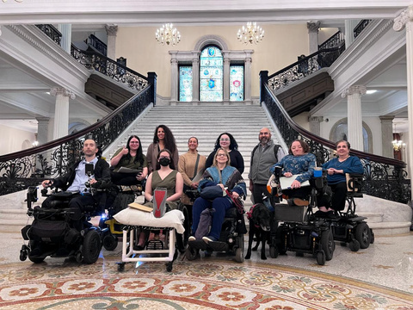
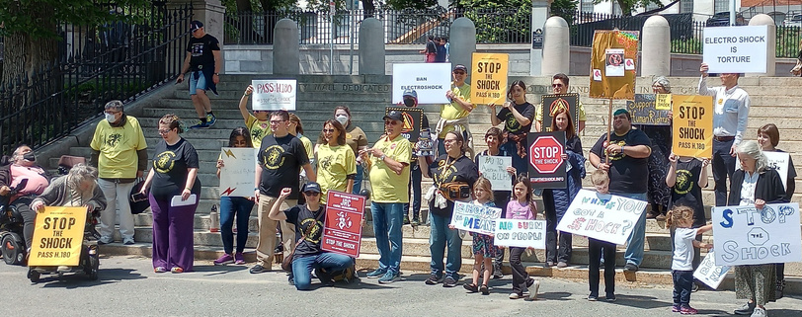
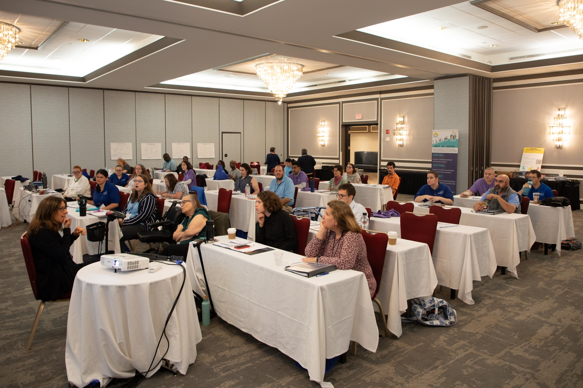
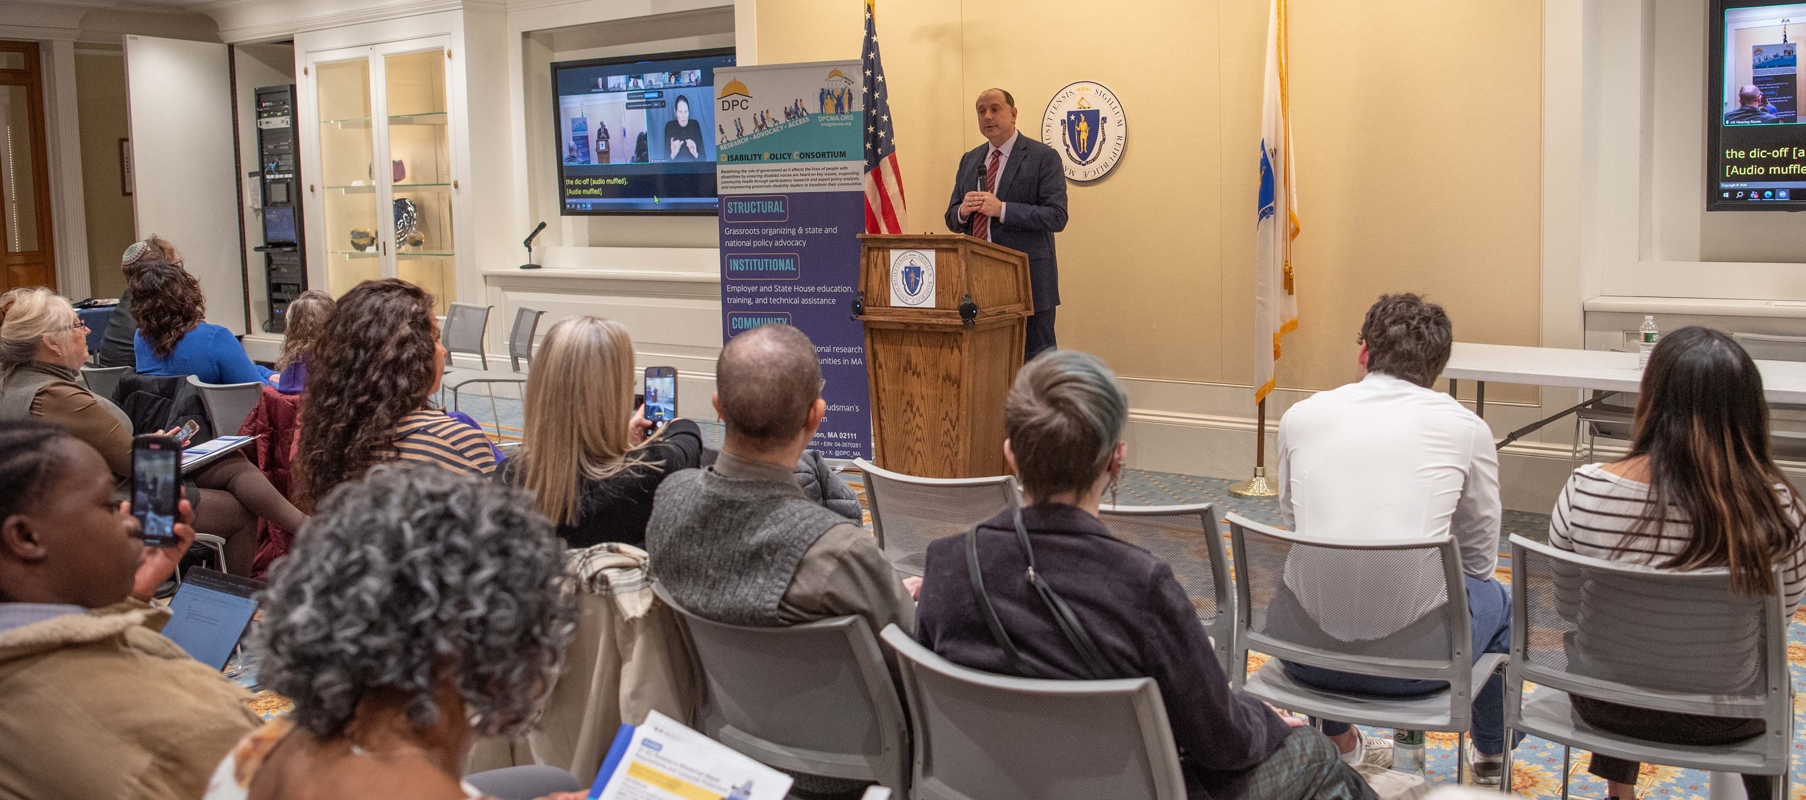

Slide 7
Research
Community-based, participatory action research (CBPAR)
Unique approach to studying disparities faced by disability community
Lived experience (LE) experts – people with disabilities and experience with specific issue being studied conduct interviews and focus groups with participants
Current research areas include
  HCBS in Latino/Spanish-speaking communities in Springfield (AcademyHealth and Robert Wood Johnson Foundation)
  One Care Care Coordination (Community Living Policy Center (CLPC) at Brandeis University)
  Progressive Employment (Institute for Community Inclusion (ICI) at UMass Boston)

Slide 8
Training and Consulting
Trainings on disability history, disability competent care, disability inclusion, and community awareness
Consulting and technical assistance on workplace inclusion, member experience evaluations, community engagement, and accessible practices
Recent and current projects include:
  Profiling PCAs and consumer-employers with BCBS Foundation
  ABLE Lab: Civic Engagement cohort with Boston Disabilities Commission
  Full-day training on accessible abortion care
Learn more here: https://www.dpcma.org/disability-dei

Slide 9

My Ombudsman
MA's state Medicaid ombudsman program for all of MassHealth
  Only one in the country run by a CBO
Anyone on MassHealth (One Care, ACOs, fee-for-service, etc) can call My Ombudsman for help understanding their benefits, getting access to services, appealing a denial, etc
Report trends to MassHealth
Partner with other organizations for outreach to community
Learn more and reach out here: https://www.myombudsman.org

