Slide 1
Presentation for:
Dignity alliance massachusetts
September 27, 2023

Slide 2
PRESENTED BY:
DAVID ROUSCH
VICE-CHAIR, NAVIGATOR HOMES OF MARTHA’S VINEYARD (NHMV)
PARTNER, STRATEGIC CARE SOLUTIONS, LLC
PADDY MOORE
BOARD MEMBER, NAVIGATOR HOMES OF MARTHA’S VINEYARD, (NHMV)
FOUNDER, BOARD MEMBER HEALTHY AGING MARTHA’S VINEYARD (HAMV)

Slide 3
HISTORY 2015 – 2021
Healthy Aging MV to Navigator Homes
¶ Searches for a better Nursing Home
Dr. William Thomas, MD, Gerontologist, and transformative thinker: – “What we need is a radical reinterpretation of longevity that makes elders and their needs central to our collective pursuit of happiness and well-being.”
¶ Green House Model
¶ Feasibility Study 2015 with Terri Sult, President, Chi Partners
¶ Institute for Healthcare Improvement, Dr. Donald Berwick—4 M’s
¶ MV Hospital Leadership Changes; truth telling and new partnership
¶ Importance of Data Gatherings: Two surveys of MV Older Adults (2015-2016 and 2020)

Slide 4
DEVELOPER SERENDIPITY 2018 – 2020
¶ Renee Lohman, Developer, Navigator Elder Homes of New England, The Green
House Project, and LWDA, Architects
¶ RFP and contract; negotiations on Asset Transfer Agreement, etc.
¶ Navigator Homes of MV Board of Directors organized and expanded
¶ MV Hospital as partner – in planning, housing, and fundraising
¶ Green House leadership crucial all along the way

Slide 5
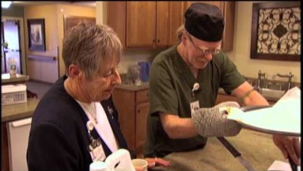
Video of What It is Like Living in a Green House Home
(Where Love Matters)

Slide 6
Why the Green House Model? Four Principles
I. Real Home
¶ Commitment to dining/food convivium
¶ Elimination of anything contrary to Real Home
No institutional dress, signage, alarms, furniture, fixtures, etc.
Smells, looks, feels like a real, normal home
¶ Design of space throughout
¶ Separate short term rehab—long term care
II. Meaningful Life for all residents
¶ Deep knowing of elders by all staff—including history, preferences, and passion, etc.
¶ Rhythm and routine in each home determined by elders and “Shahbazim”
¶ Elder autonomy and control in daily decisions regarding sleep, access to kitchen, etc.
¶ Purposeful engagement of residents
¶ “Shahbazim” are partners with each patient, with activities staff, etc.

Slide 7
Why the Green House Model? Four Principles (Continued)
III. Empowered Staff
¶ Empowered workforce model—flattened hierarchy to shift institutional beliefs, behaviors, and systems
¶ Universal worker model in self-managed work teams—dedicated, consistent staffing
¶ Utilize Green House coaching approach with Guide role as supervisor to the self-managed work team
¶ Shared decision-–making is conducted in Green House’s collaborative manner
¶ Clinical Support Team approach integrates Green House principles
IV. Model Support for Sustainability
¶ Implement and sustain Green House education for newly-hired staff
¶ Demonstrate commitment to growth and develop of current employees
¶ Annual participation in data collection for Green House and Center for Innovation
¶ Annual dues payment to Peer Network
¶ Commitment to a Home for Life philosophy

Slide 8
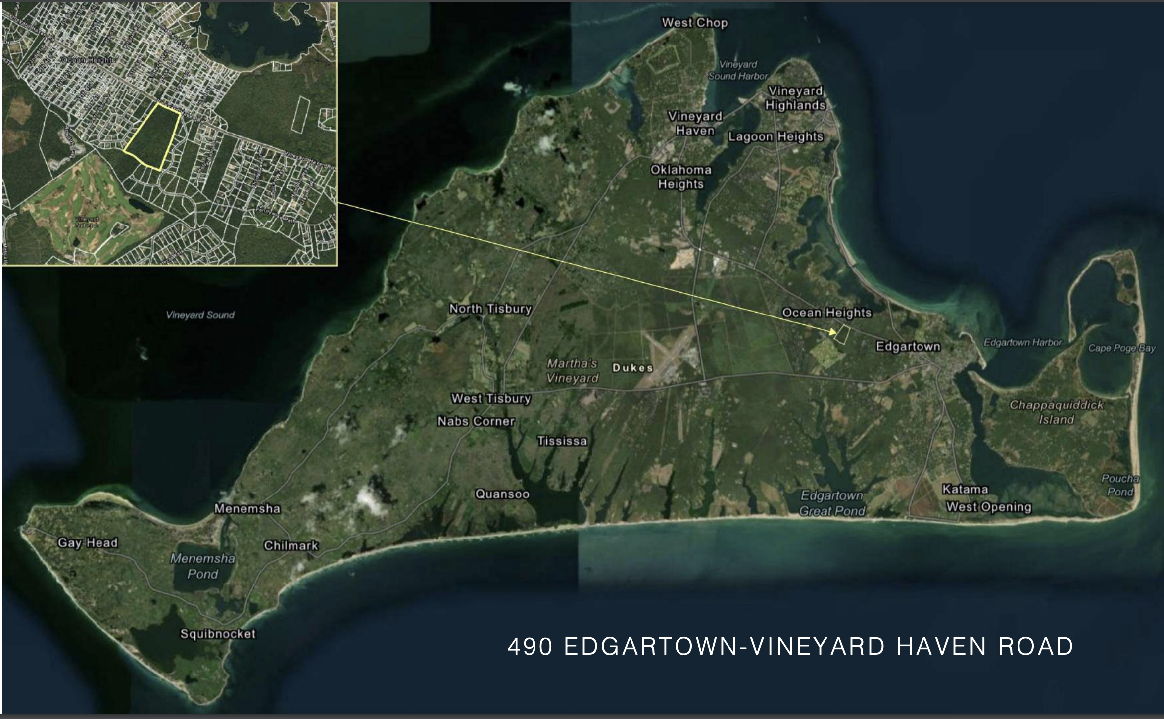
PROJECT LOCATION ON MARTHA’S VINEYARD

Slide 9
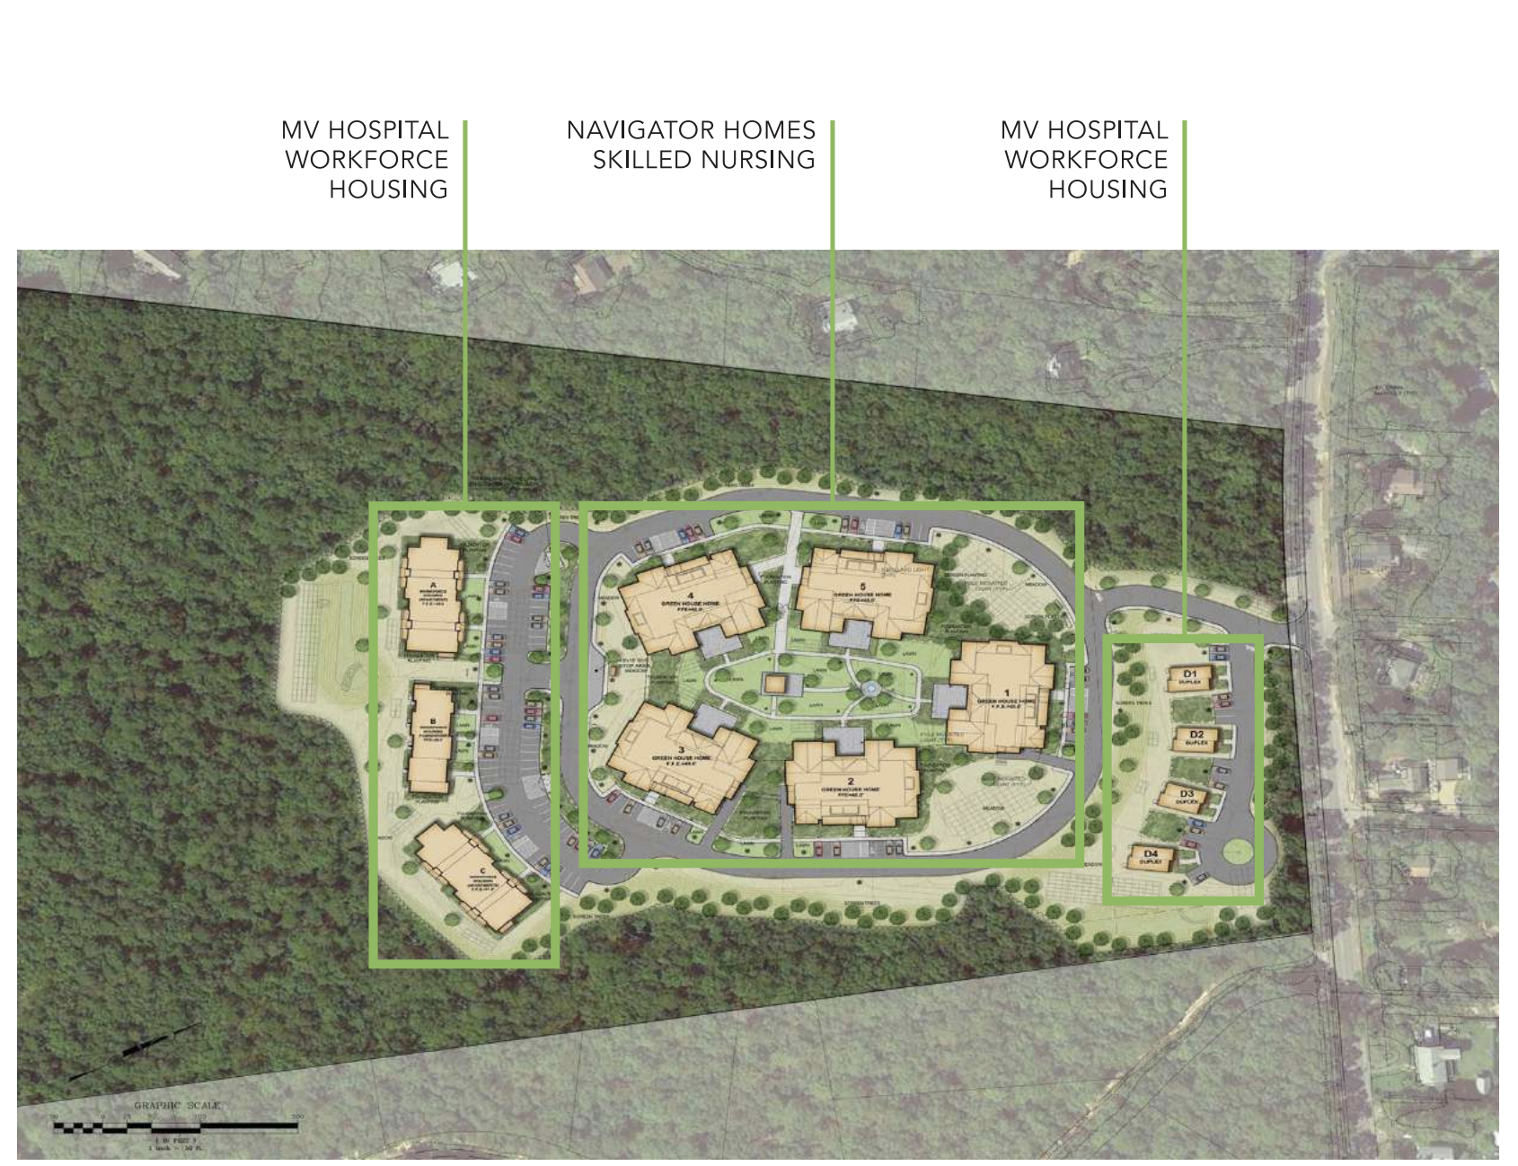
ARCHITECTURAL LOCUS OF SITE PLAN

Slide 10
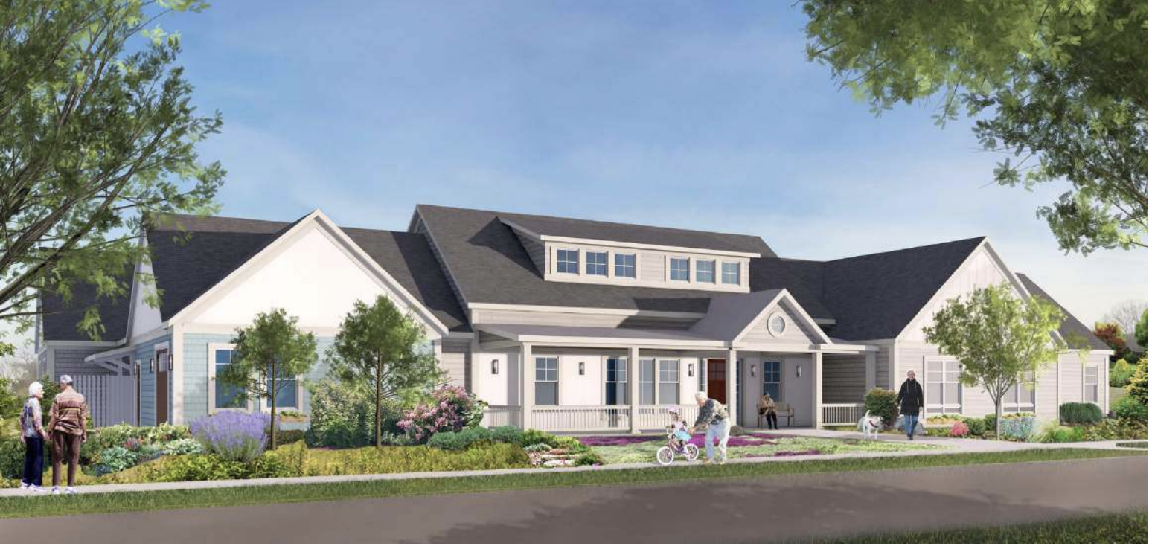
ARCHITECTURAL RENDERINGS OF NAVIGATOR HOMES OF MV
Front Facade

Slide 11
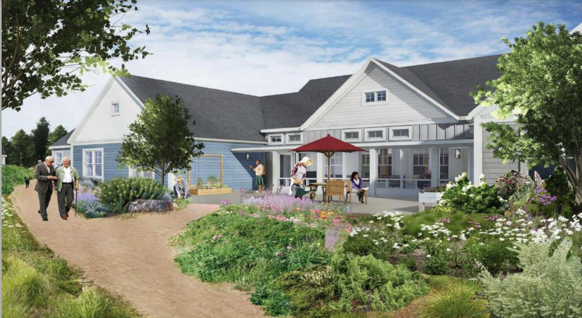
ARCHITECTURAL RENDERINGS OF NAVIGATOR HOMES OF MV
Rear Façade of all Five (5) Green House Homes will face into a Pocket Park

Slide 12
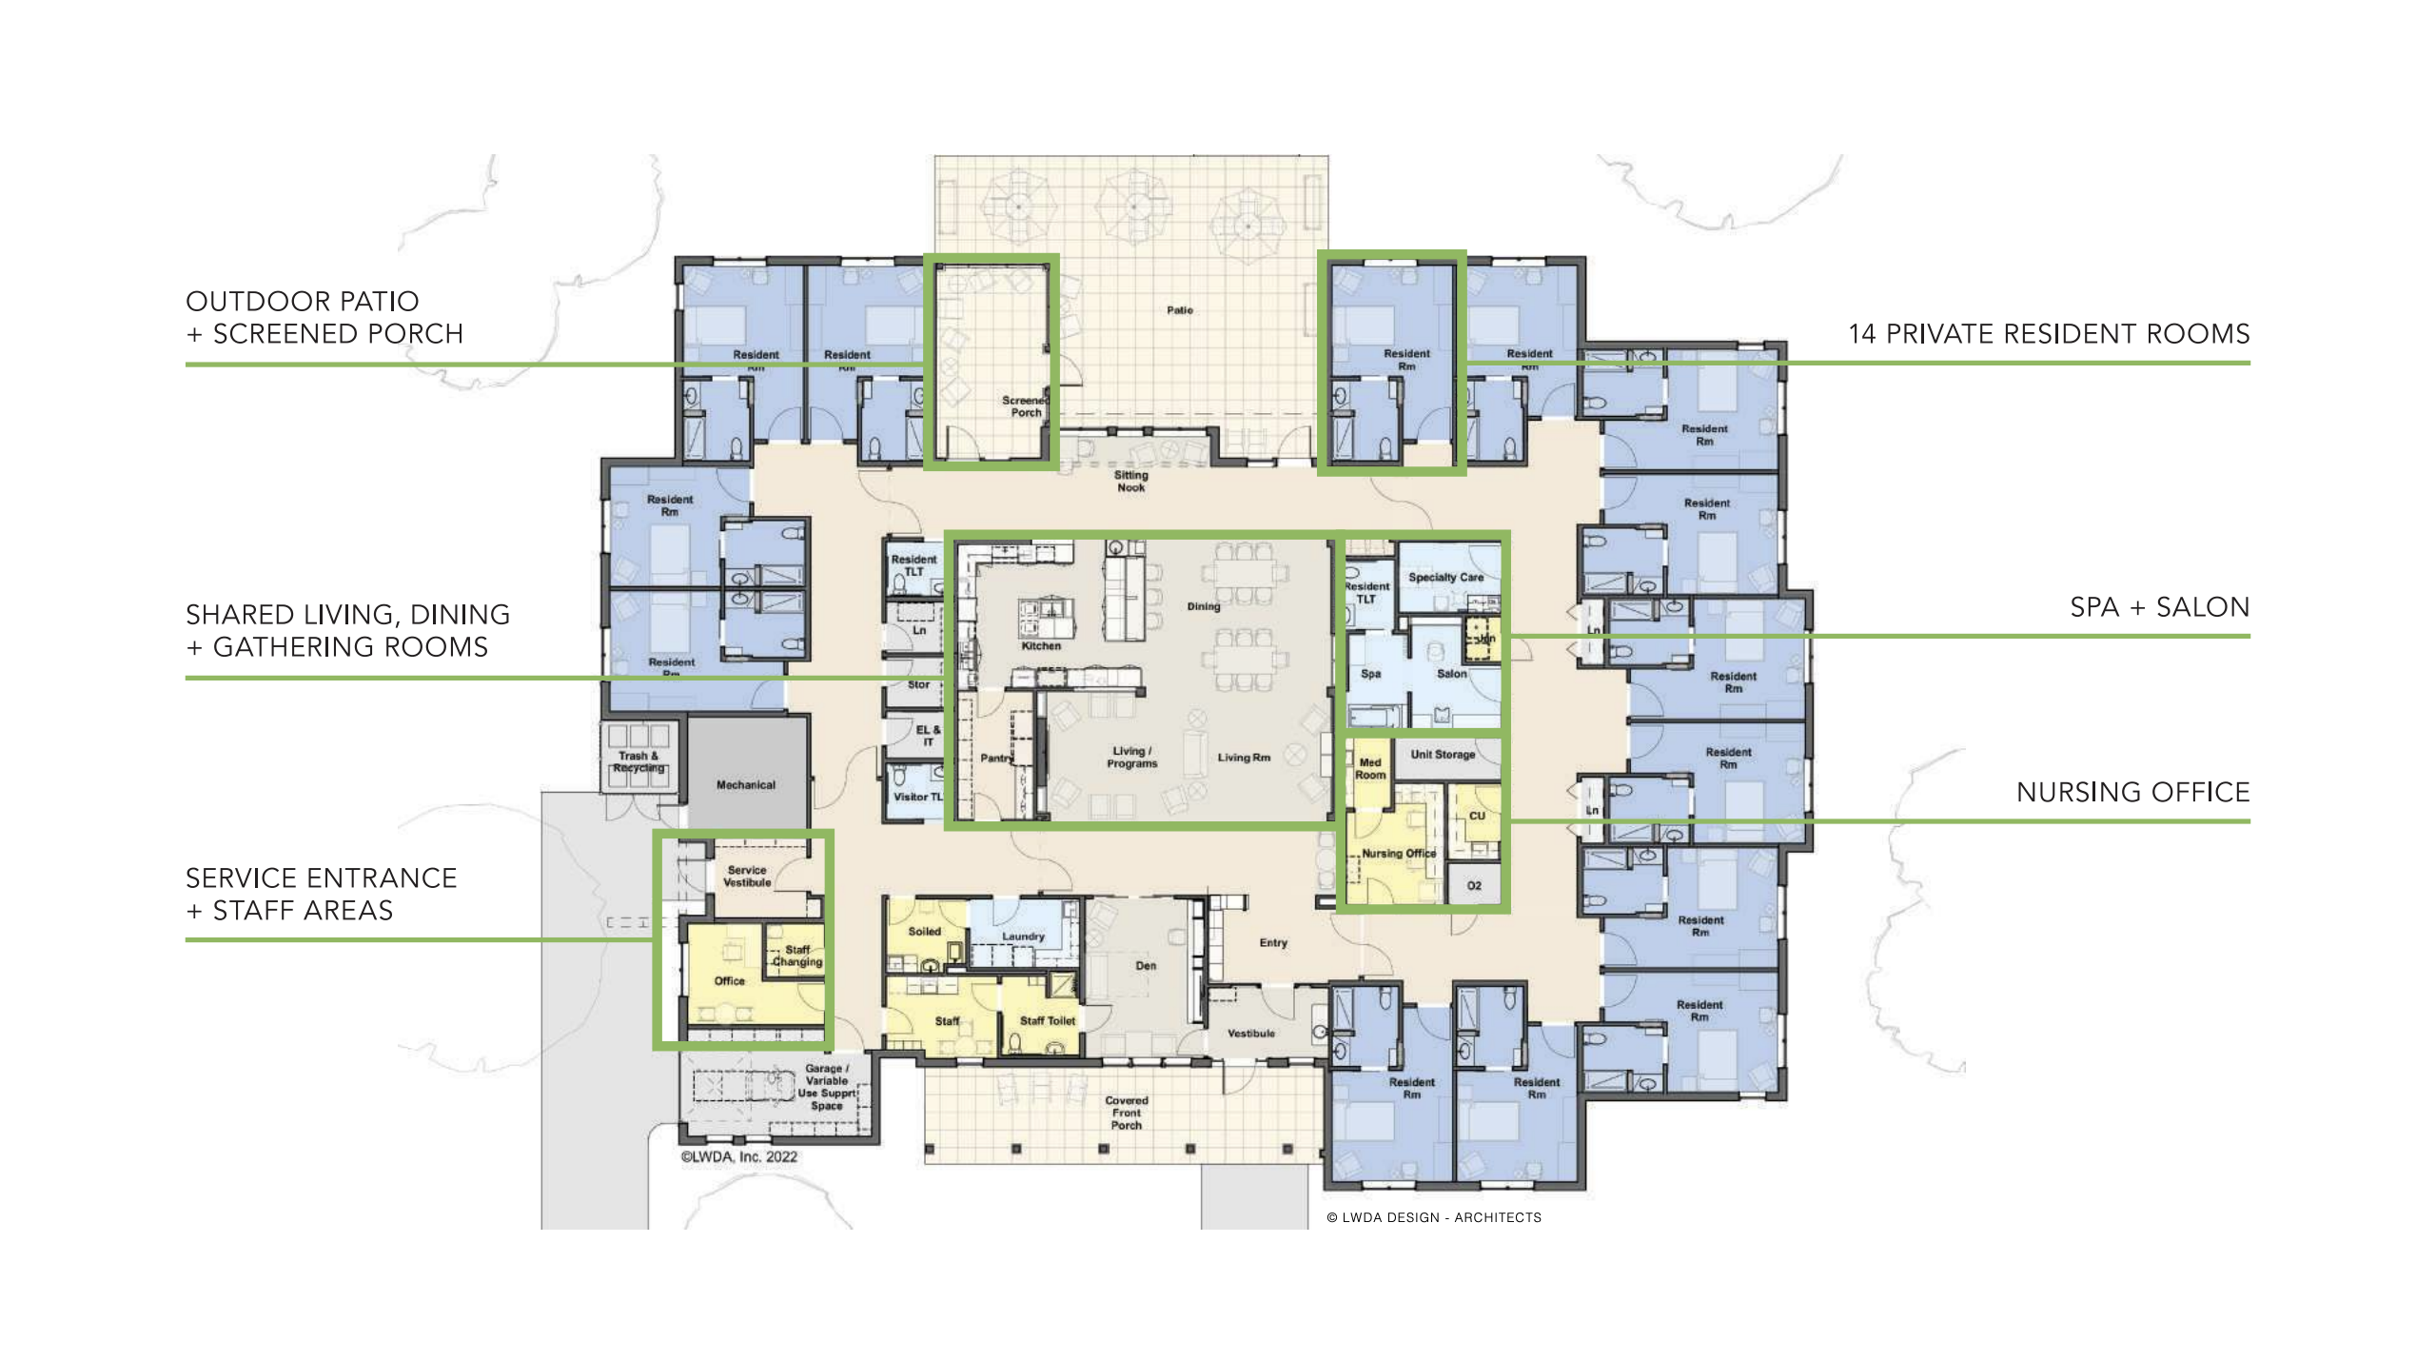
ARCHITECTURAL RENDERINGS OF NAVIGATOR HOMES OF MV
Floor Plan Layout

Slide 13
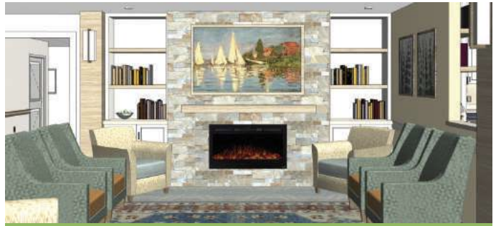
ARCHITECTURAL RENDERINGS OF NAVIGATOR HOMES OF MV
Shared Common Living Room Space with Fireplace

Slide 14
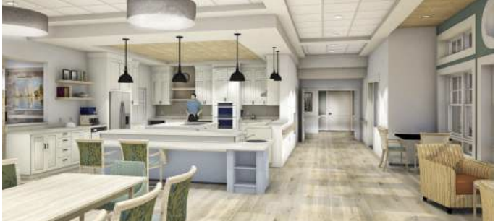
ARCHITECTURAL RENDERINGS OF NAVIGATOR HOMES OF MV
Fully Accessible Common Kitchen and Dining

Slide 15
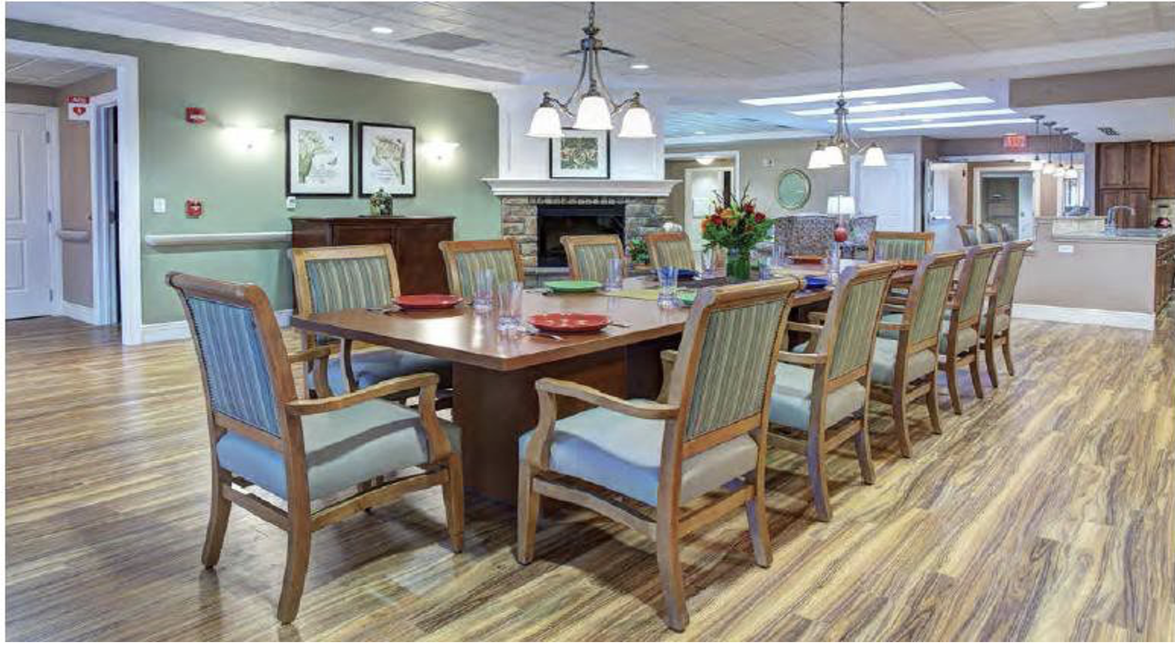
ARCHITECTURAL RENDERINGS OF NAVIGATOR HOMES OF MV
Dining and Food Convivium is Encouraged

Slide 16
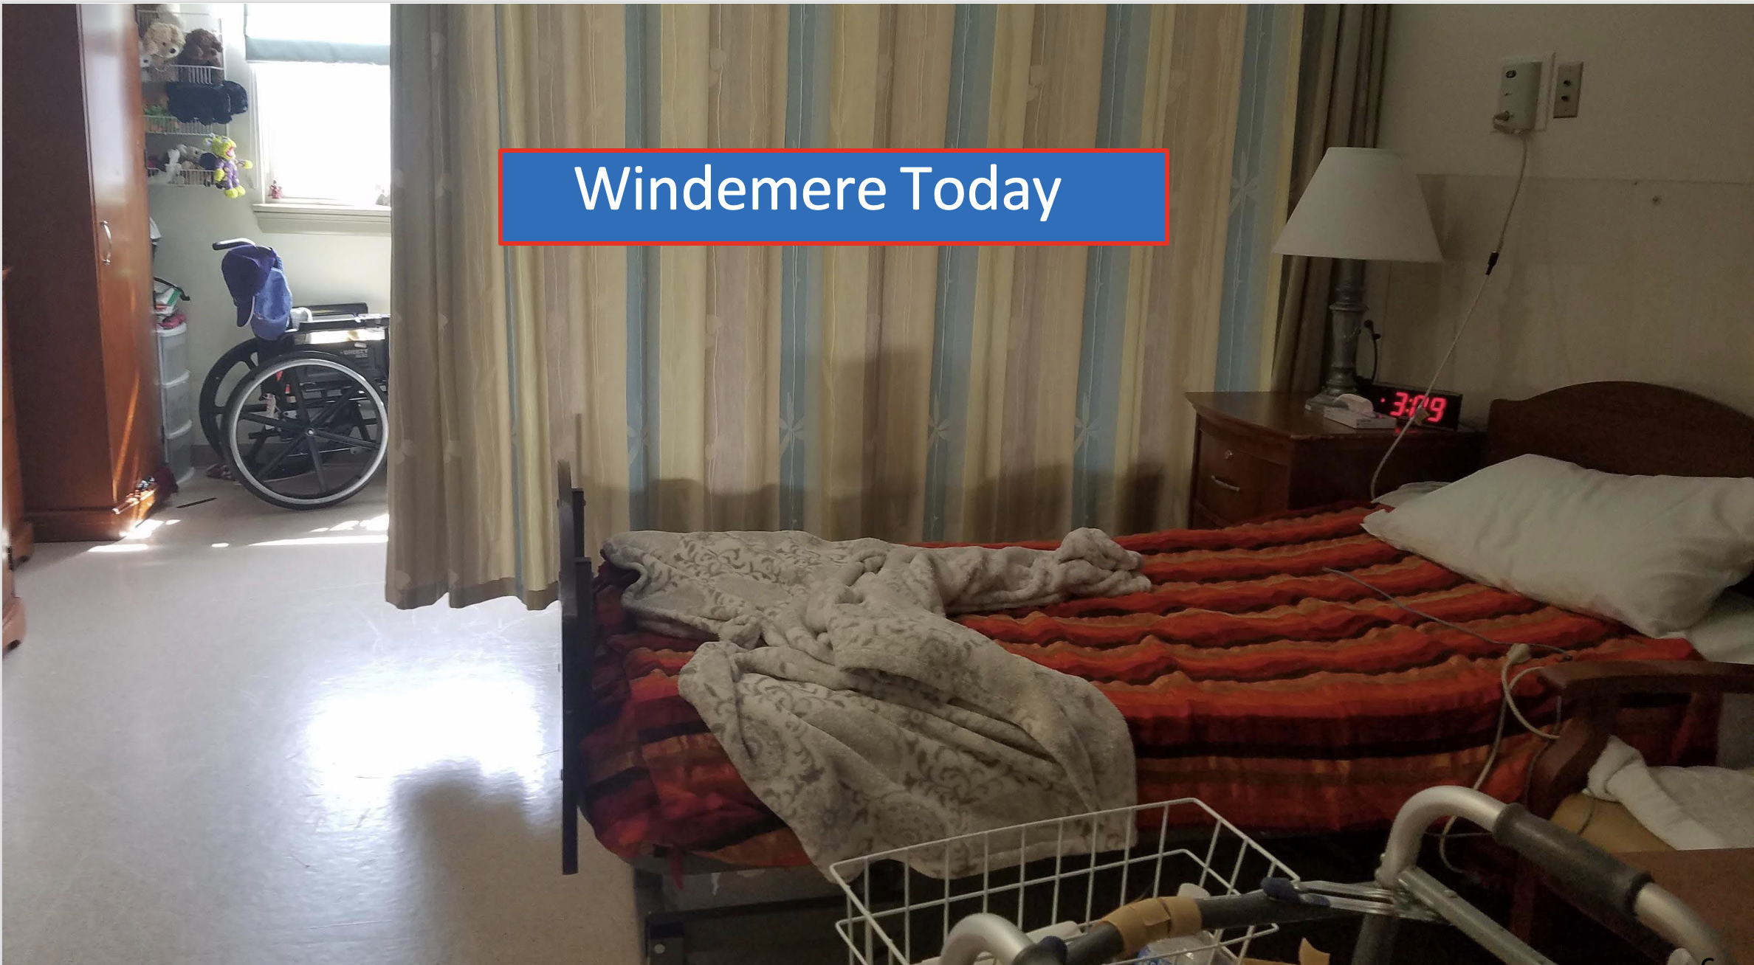
ARCHITECTURAL RENDERINGS OF NAVIGATOR HOMES OF MV
This is a picture of a Typical Nursing Home Bedroom Layout in Massachusetts.
¶ Each Resident Shares a Bedroom with an- other Resident. The only privacy is a pull curtain.
¶ Those two Residents share One bathroom with two other
Residents so there are
Four Residents per
One bathroom.

Slide 17
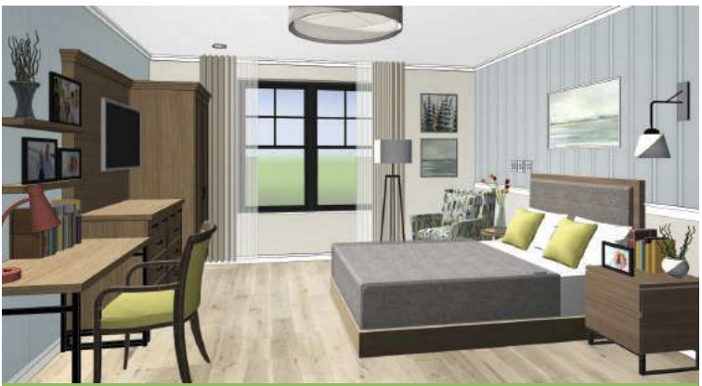
ARCHITECTURAL RENDERINGS OF NAVIGATOR HOMES OF MV
Private Bedroom and Private Bathroom for each Resident

Slide 18
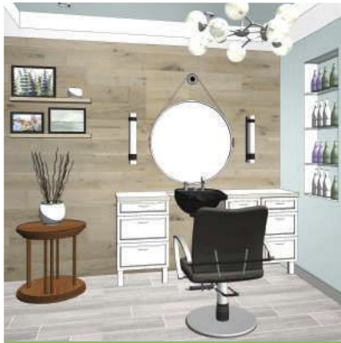
ARCHITECTURAL RENDERINGS OF NAVIGATOR HOMES OF MV
In Each of the Five Homes, Other Amenities Include:
¶ Spa and Salon
¶ Covered Front Porch
¶ Screened-In, Fully Accessible
Back Porch Overlooking the Pocket Park
¶ Rear Landscaped Patio

Slide 19
DEVELOPMENT PROCESS AND PROJECT TIMELINE 2021
MAY 2021
Town of Edgartown, MA
Town Meeting Zoning Approval
JULY 2021
Martha’s Vineyard Hospital
Purchases 28 acres of Land - Housing

Slide 20
DEVELOPMENT PROCESS AND PROJECT TIMELINE 2022
MAY 2022
Asset Transfer Agreements
SEPTEMBER 2022
USDA Financing Commitments
DECEMBER 2022
Martha’s Vineyard Commission Approval
Town of Edgartown, MA
Wastewater Approval

Slide 21
DEVELOPMENT PROCESS AND PROJECT TIMELINE 2023
MARCH 2023
Town of Edgartown, MA
Planning Board Approval
APRIL 2023
Department of Public Health Council
Approves Determination of Need (DON)

Slide 22
DEVELOPMENT PROCESS AND PROJECT TIMELINE 2023 (Continued)
MAY 2023
Hebrew Senior Life contract to manage
Navigator nursing home operations
Site Preparation Work commences
SEPTEMBER 2023
Pad-ready Site Completed
Town of Edgartown, MA issues Building
Permit

Slide 23
DEVELOPMENT PROCESS AND PROJECT TIMELINE 2025
AUGUST 2025
Construction Work Complete
AUGUST 2025
Windemere Residents Move to Navigator

Slide 24
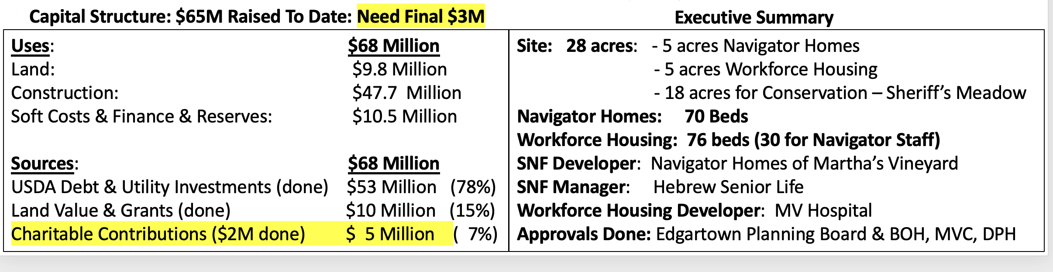
NAVIGATOR HOMES OF MV FINANCING & EXECUTIVE SUMMARY

Slide 25
BARRIERS AND CHALLENGES
¶ Renee Lohman’s death--May 2022
¶ Resistance to Change From Windemere--Navigator
¶ Suspicion of Nursing Home Industry
¶ NIMBY
¶ Stereotype of Martha’s Vineyard
¶ Islanders’ attitudes toward Medicaid, Medicare, Private Pay
¶ Fundraising – both public and private
¶ Multi-layer and multi-agency Regulation Processes

Slide 26
OPPORTUNITIES
¶ Hospital desperate for housing led to 30 beds for Navigator Homes staff
¶ Washington DC attitude toward Martha’s Vineyard and the USDA Regional Office
¶ Complex DPH processes and delays, but new State leadership
¶ Strong political support; local, state, and federal
¶ Green House requirements but leadership support and experience
¶ Hebrew Senior Life expertise and alliance

Slide 27
THANK YOU
FOR GIVING US THIS
PRESENTATION OPPORTUNITY
FOR ADDITIONAL INFORMATION, PLEASE CONTACT:
PADDY MOORE MOOREIIPADDY@GMAIL.COM OR
DAVID ROUSH DRoush@StrategicCareS.com

